Slide 1
SQL MAPPING
INJECTION

Slide 2
Purpose and Usage of SQLMap:
Detect SQL Injection Vulnerabilities:
SQLMap is primarily used to identify SQL injection vulnerabilities in web applications.
These vulnerabilities occur when user input is not properly sanitized, allowing attackers to execute arbitrary SQL commands.
Exploit Vulnerabilities: Once a vulnerability is detected, SQLMap can exploit it to retrieve sensitive data from the database, escalate privileges, or even execute commands on the underlying system.

Slide 3
Damn Vulnerable Web Application. I
Educational Tool: DVWA is designed to provide a hands-on learning experience for individuals interested in web application security. It allows users to practice and improve their skills in identifying, exploiting, and mitigating common web application vulnerabilities.
Vulnerabilities: DVWA contains a variety of security vulnerabilities intentionally built into the application. These vulnerabilities include but are not limited to:
SQL injection
Cross-Site Scripting (XSS)
Command Injection
File Inclusion
Brute Force Attacks
File Upload Vulnerabilities
Security Levels: DVWA offers different security levels ranging from low to high. Each security level increases the complexity of the vulnerabilities, making it progressively more challenging for users to exploit them. This allows users to start with basic vulnerabilities and gradually advance to more advanced techniques as they gain experience and confidence.
Practice Environment: DVWA provides a safe and controlled environment for users to practice their skills without the risk of causing harm to real-world systems. Users can exploit

Slide 4
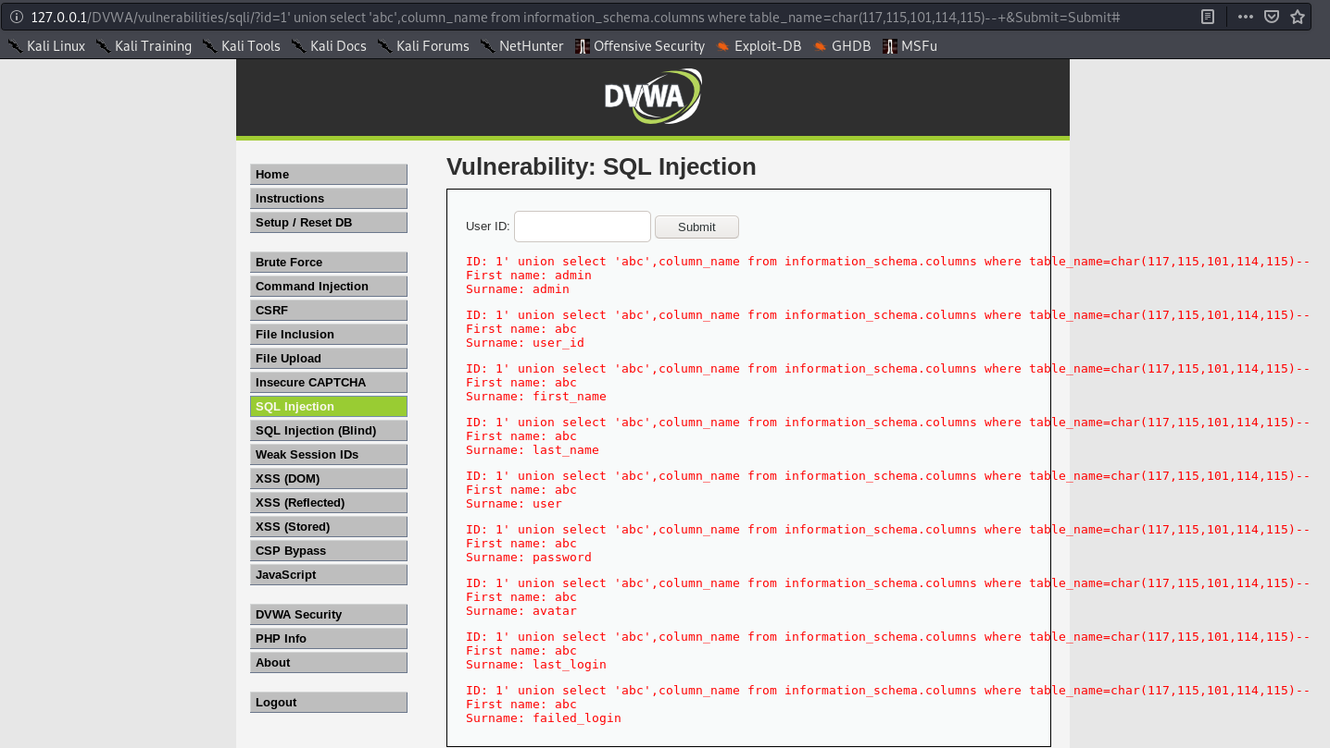
VULNERABLE SQL INJECTION

Slide 5
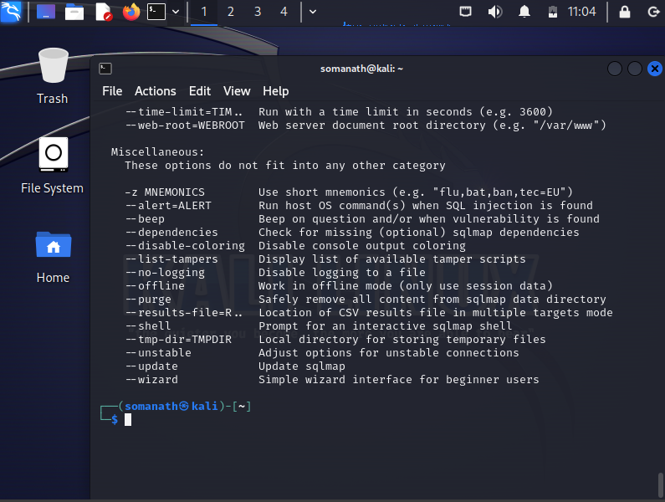
SQL MAPING AND INJECTION

Slide 6
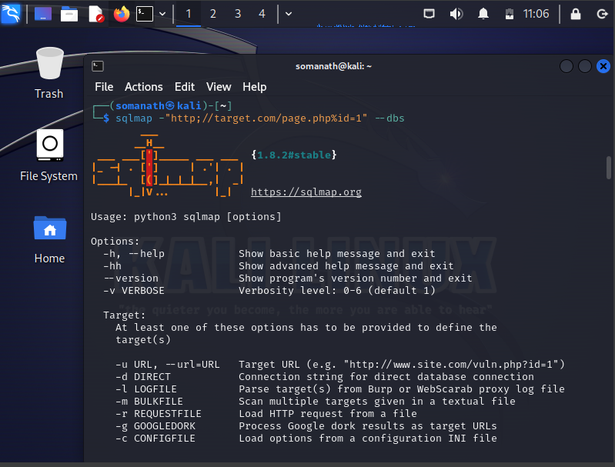
INSTALLING PROCESS

